Slide 1
Seattle Data AI Security Hackathon Team 4

Slide 2
Topic: AI-Powered Multi-Agent Tutoring System
Enhancing Learning through AI Collaboration
Members
Megha Narendra Simha
Neha Arora
Pratham Balaji
Eshwar
AI-Powered Multi-Agent Tutoring System​
cing Learning through AI Collaboration

Slide 3
Agenda
Introduction
Problem Statement
Solution Overview
System Architecture and Technologies Used
Key Features, Use case and Impact
Challenge and Future Work
Final tips & takeaways

Slide 4
Introduction
Overview of the Project:
This project aims to create an AI-powered tutoring system designed to offer personalized learning experiences for students.
It leverages multi-agent collaboration where different AI agents (instructors, peers, and progress trackers) work together.
Purpose:
To enhance traditional tutoring methods by integrating AI-driven, scalable learning solutions.
Allow for interdisciplinary connections between different subjects, aiding students in their learning journey.

Slide 5
Problem Statement
Challenges in Traditional Tutoring:
Traditional tutoring can be time-consuming, resource-intensive, and often lacks scalability.
Limited capacity for personalized learning paths for each student.
Need for Scalable Learning Solutions:
With increasing class sizes and diverse student needs, a scalable solution is crucial.
AI can automate personalized learning paths for each student, making it more efficient.
How AI Can Help:
AI allows for real-time adaptability, helping the system provide specific content based on a student's learning pace and style.
AI agents can identify gaps in students' knowledge and suggest appropriate interventions.

Slide 6
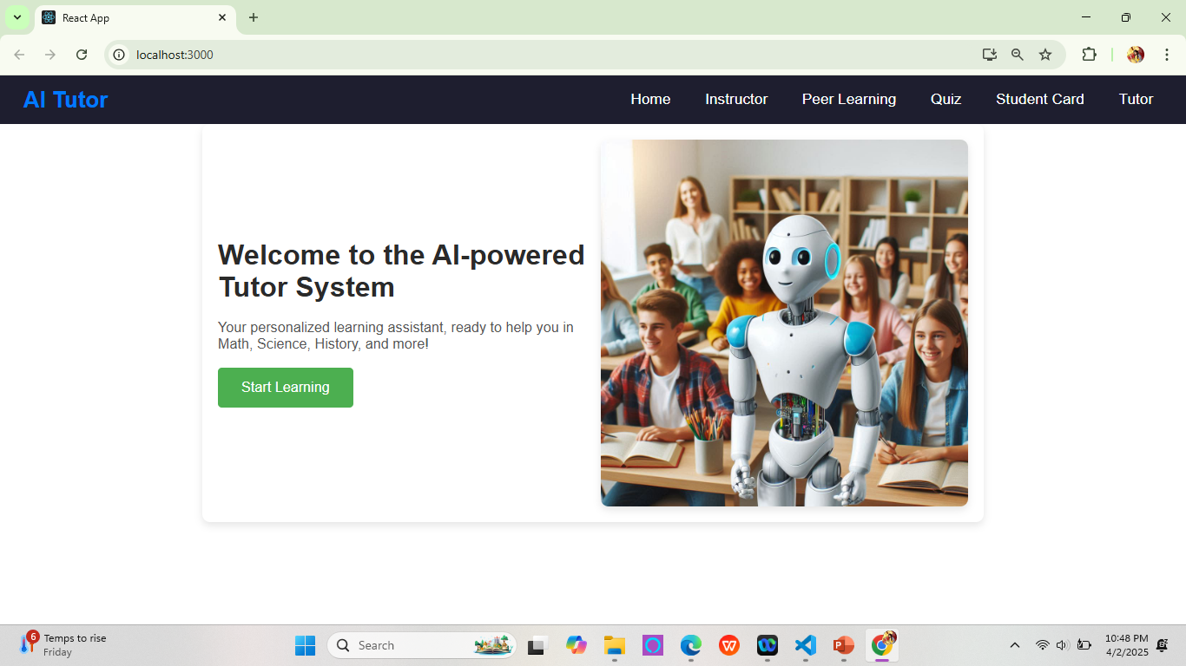
Home Page

Slide 7
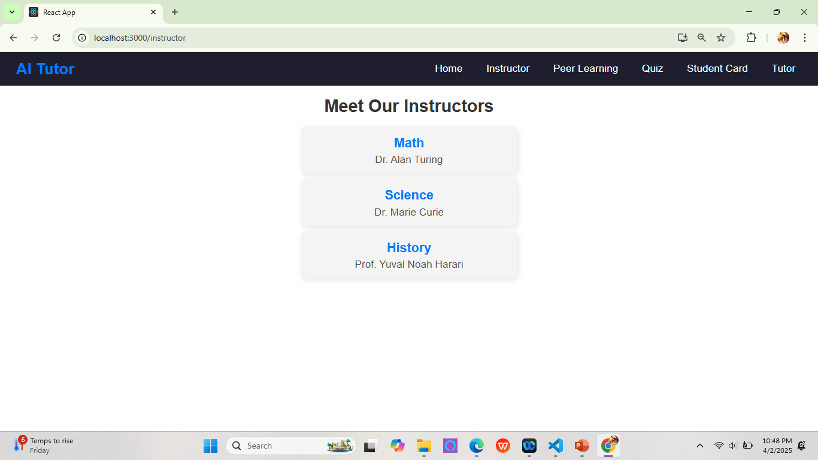
Instructor Page

Slide 8
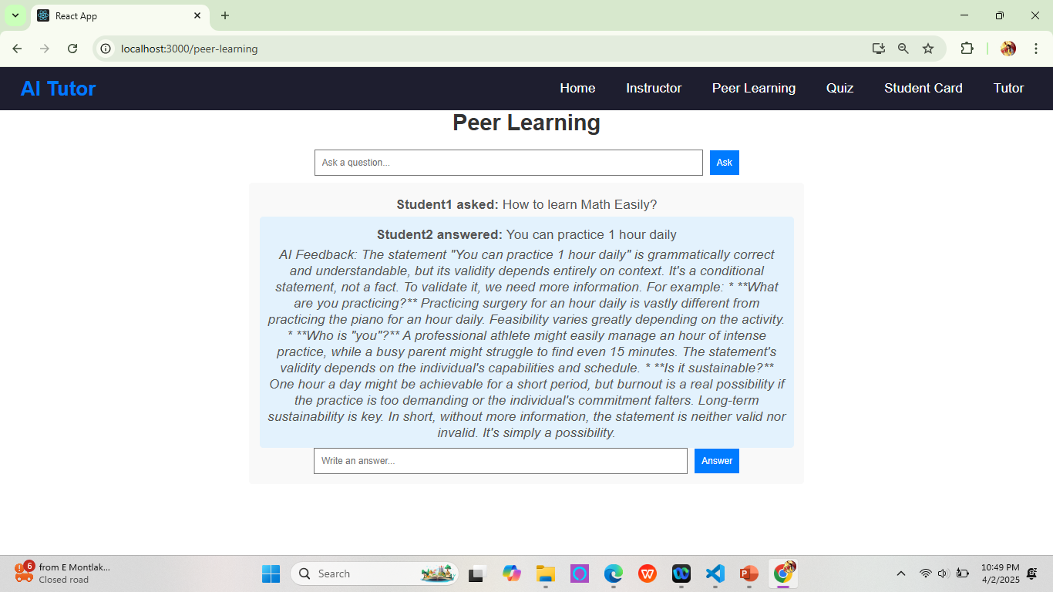
Peer Learning Page

Slide 9
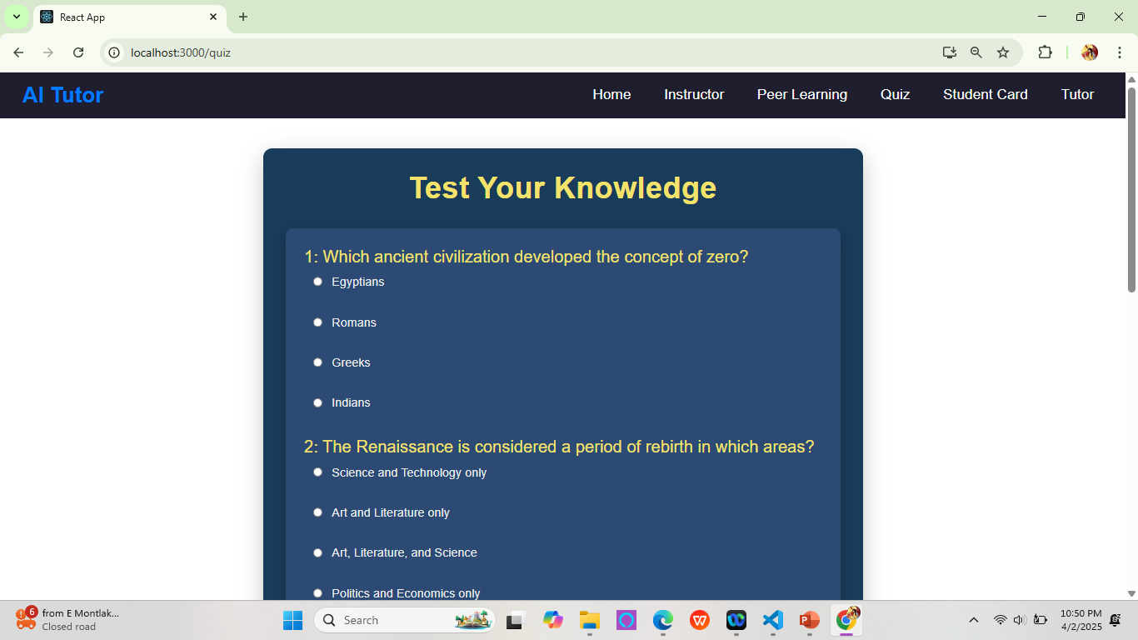
Quiz Page

Slide 10
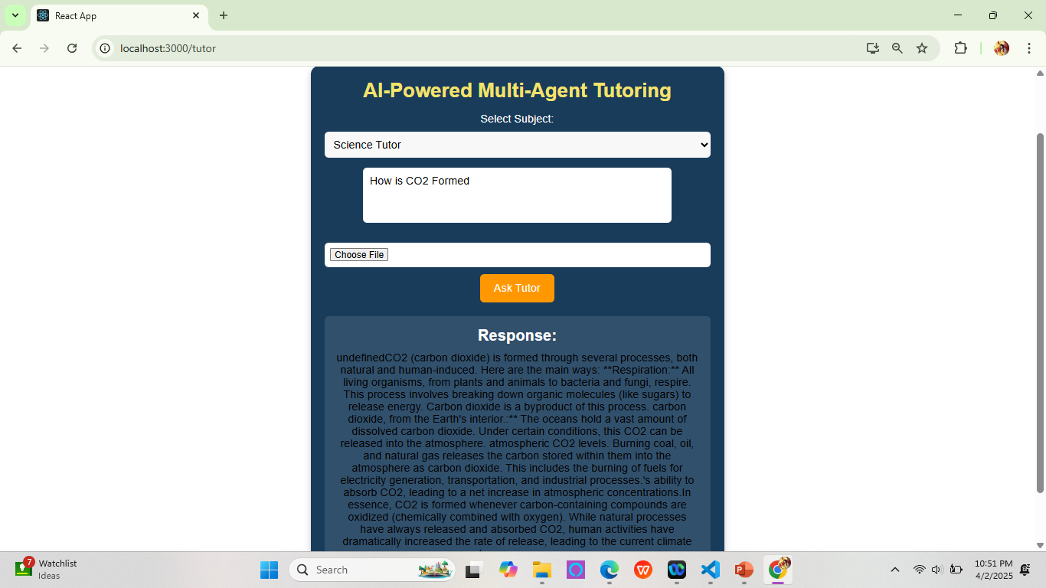
AI Tutor Page

Slide 11
System Architecture and Technologies Used

Slide 12
Key Features, Use case and Impact

Slide 13
Challenges and Future Work

Slide 14
Final tips & takeaways
Consistent rehearsal
Strengthen your familiarity
Refine delivery style
Pacing, tone, and emphasis
Timing and transitions
Aim for seamless, professional delivery
Practice audience
Enlist colleagues to listen & provide feedback
Seek feedback
Reflect on performance
Explore new techniques
Set personal goals
Iterate and adapt

Slide 15
Thank you
Team 4

